Slide 1
Hotel Booking Management
Capstone Project
Submitted By - Sidharth C

Slide 2
Introduction
In this presentation, I will be explaining my Hotel Management Web Service project, which currently encompasses core functionalities essential for efficient operation. I have successfully implemented systems for managing users, hotels, and rooms, as well as integrated services for booking and processing payments. These components work together seamlessly to create a robust and user-friendly platform that meets the critical needs of both hotel administrators and guests. The focus of today’s discussion will be on how these functionalities were developed, the challenges encountered along the way, and the solutions employed to overcome them

Slide 3
Problem Statement
To Create an Application for Hotel Booking Management System
Customer should be able to perform below operations:
- Customer should be able to view the list of hotels, rooms available.
- Customer should be able to book the rooms of the hotel.
Admin should be able to perform below operations:
1.Hotel Management
- add, update, delete, view hotels
2.Rooms management
- add, update, delete, view rooms
3. Payments
- accept and view the payments

Slide 4
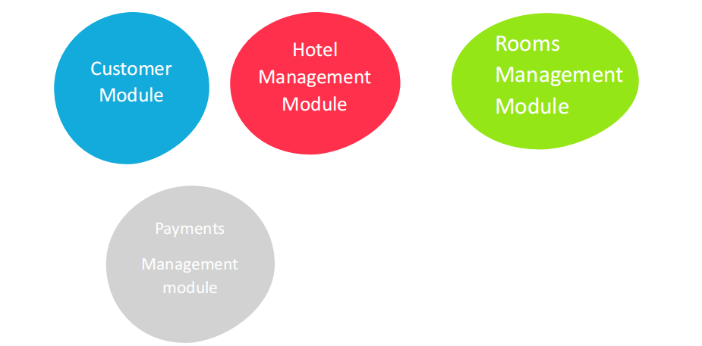
Modules

Slide 5
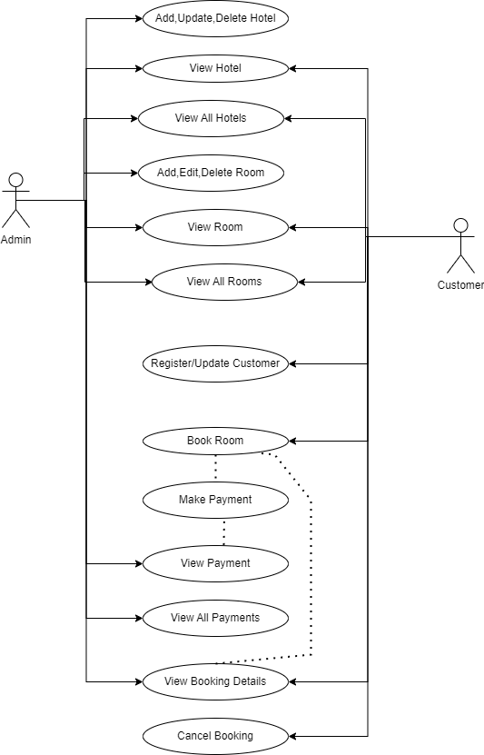
Use Case Diagram

Slide 6
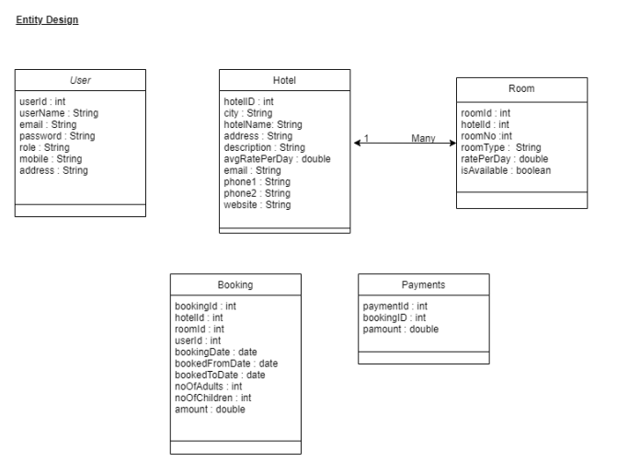
Entity Classes

Slide 7
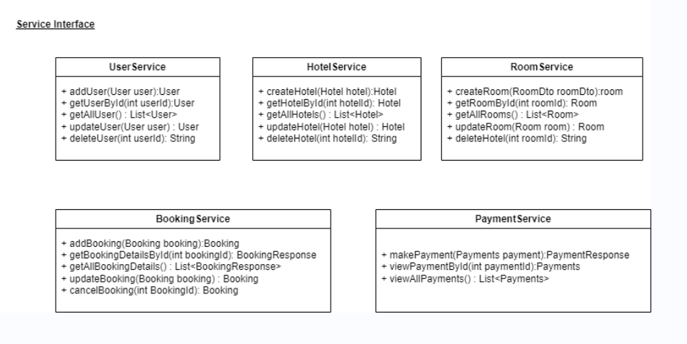
Service Interfaces

Slide 8
Future Scope
As we look to the future development of the Hotel Management Web Service, enhancing the security framework is a primary focus. The upcoming improvements are designed to ensure that our system is not only functional and user-friendly but also secure and compliant with the best industry practices.

Slide 9
Conclusion
To conclude, the Hotel Management Web Service I developed effectively integrates core functionalities for managing users, hotels, rooms, bookings, and payments. This provides a robust and efficient system that enhances the user experience and operational management. Acknowledging the current lack of advanced security features, I have planned and am committed to implementing comprehensive security upgrades to ensure our platform aligns with the highest industry standards. I am dedicated to continuously improving and expanding this service to meet evolving user needs and technological advancements. Thank you for your attention, and I am excited about the future enhancements and the value they will add.

Slide 10
Thank You

